Slide 1

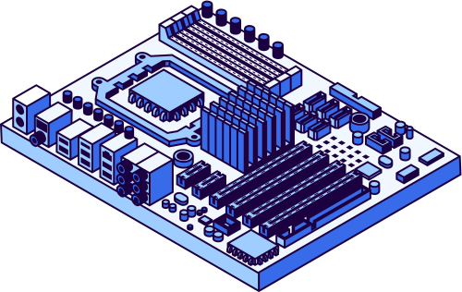
ELECTRONAUTS
2025
DEVELOPMENT OF A MCU-BASED ANALOG SENSING DEVICE
AGASARO LAURA
ABAYO PACIFIQUE
KWIHANGANA JEAN MARC

Slide 2
ELECTRONAUTS
2025
PROJECT OBJECTIVE
Design and implement a microcontroller (MCU)-based system capable of acquiring multiple analog sensor inputs, displaying readings on an external Liquid Crystal Display (LCD), and transmitting data via a communication port. The system must also utilize external indicators (LEDs) for real-time feedback based on sensor values.

Slide 3
ELECTRONAUTS
2025
CORE FEATURES
3 Analog Sensors: LDR, Temperature, Magnetic (Hall-effect).
16x2 LCD for real-time display.
Visual indicators for thresholds and status.
ATmega328P Microcrontroller

Slide 4
ELECTRONAUTS
2025
POWER MANAGEMENT
USB POWER SUPPLLY
ESD&PI FILTER
LDO
ESD Protects electronics from electrostatic discharge by redirecting high-voltage spikes to ground.
Pi Filter Reduces electrical noise
LDOs maintain precise voltage levels (3.3V) for sensitive components despite input variations.
Output Voltage: 5V

Slide 5
ELECTRONAUTS
2025
SENSORS SPECIFICATIONS
THERMOSTAT
LIGHT DEPENDENT RESISTOR
MAGNETIC SENSOR
Temperature sensor
Analog output
Range: -40°C to 100°C
Measures light intensity.
Resistance varies with illumination.
Linear Hall-effect IC.
Supply: 2.7V–6.5V, 6mA current.
Sensitivity: 1.4 mV/Gauss.
Range: ±650 Gauss.

Slide 6
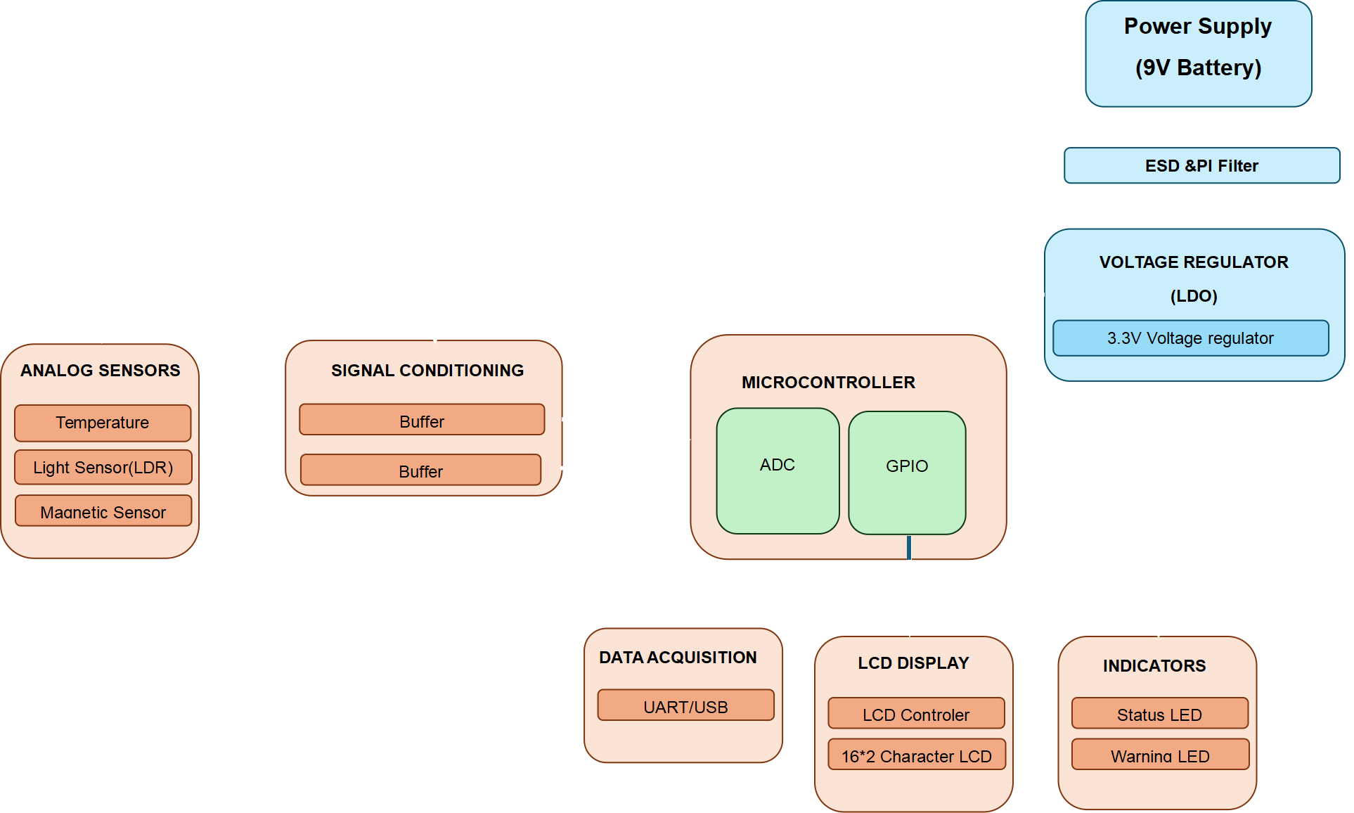
ELECTRONAUTS
2025
BLOCK DIAGRAM

Slide 7
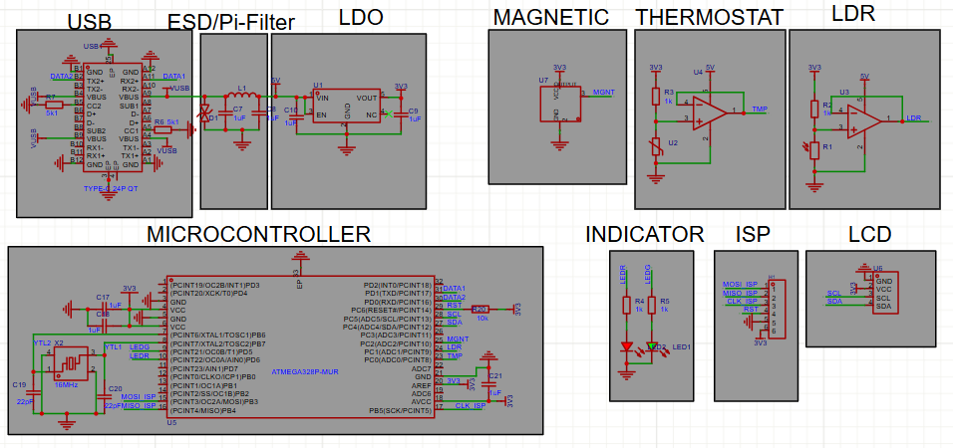
ELECTRONAUTS
2025
SCHEMATIC LAYOUT

Slide 8
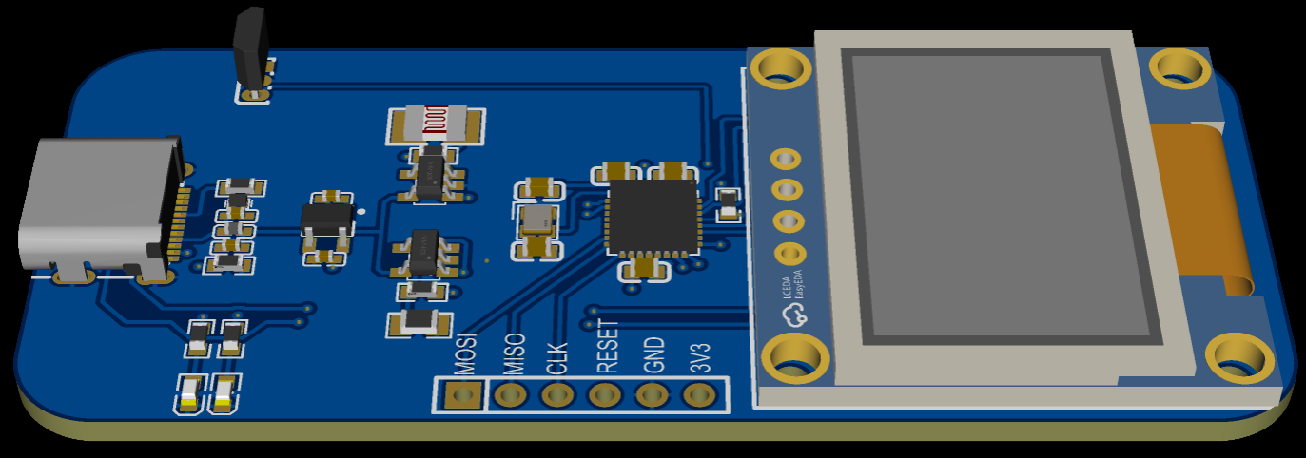
ELECTRONAUTS
2025
PCB LAYOUT

Slide 9
ELECTRONAUTS
2025
ALGORITHM
Analog Input Channels: PC0 (LDR), PC1 (TMP), PC2 (MGNT)
Display: LCD (I2C via PC4/PC5)
Communication: UART (9600 baud via PD0/PD1)
Indicators:
Green LED (PB6): Normal status
Red LED (PB7): Warning condition
System Behavior:
Reads sensors every 500ms (Timer1 interrupt)
Compares values to thresholds
Updates LCD and LEDs accordingly
Transmits data over UART

Slide 10
ELECTRONAUTS
2025
CHALLENGES & SOLUTIONS
Signal Attenuation : Place the microcontroller close to the sensor and apply signal conditioning.
USB Stability: ESD clamp diodes + Pi-Filter .
Power Budget: Optimized LDOs.
Calibration Drift: Add temperature compensation using a temperature sensor and software correction.

Slide 11
ELECTRONAUTS
2025
CONCLUSION
This MCU-based analog sensing device integrates light, temperature, and magnetic field sensors to enable real-time environmental monitoring. It is ideal for use in telecommunication base stations, where environmental factors affect signal quality and amplifier performance. By analyzing sensor data, the system can dynamically adjust amplifier gain for optimal operation. Its design includes robust power management, ESD protection, and modular expandability. This makes it a reliable and scalable solution for smart infrastructure and automated control systems.

Slide 12
ELECTRONAUTS
2025
Thank You
KAGOMA TECH 2025

